Slide 1
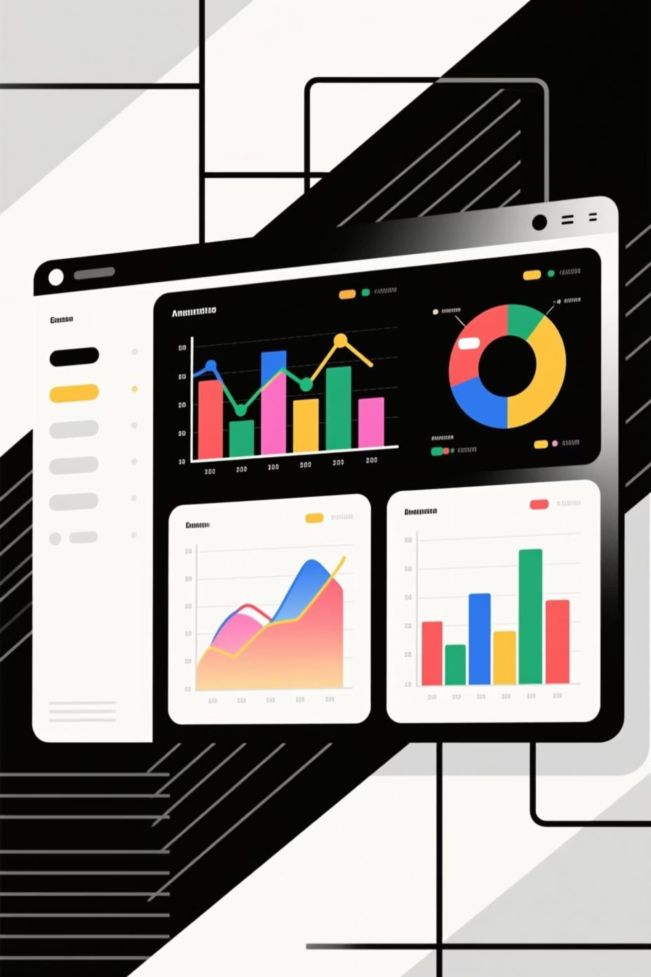
Customer Behaviour Analysis Project
Uncovering insights to drive revenue, loyalty, and strategic growth
Tools: Python | SQL Server | Power BI

Slide 2

Project Overview
The Challenge
Analyzing customer shopping behavior to identify key drivers of revenue and loyalty
Customer demographics impact
Subscription effectiveness
Product performance
Purchasing patterns

Slide 3


Business Objectives
Demographics
Understand how customer profiles impact revenue generation
Subscriptions
Evaluate effectiveness of subscription and discount strategies
Products
Identify top-performing products and categories
Loyalty
Analyze customer loyalty and repeat purchasing behavior

Slide 4
Dataset & Methodology
01
02
03
Python Analysis
SQL Queries
Power BI Dashboard
Data cleaning, validation, and exploratory analysis to ensure high data quality
Business intelligence queries to answer key revenue and behavior questions
Interactive visualizations for dynamic, user-driven insights
Demographics
Purchase Data
Behavior
Gender
Amount
Subscription Status
Age Group
Product & Category
Shipping Type
Previous Purchases
Review Ratings

Slide 5
SQL Analysis Highlights
1
2
Revenue by Gender
High-Value Discount Users
Demographic spending patterns across male and female customers
Customers using discounts while spending above average
3
4
Top-Rated Products
Shipping vs Spending
Items with highest customer satisfaction scores
Impact of delivery preference on purchase behavior
5
6
Subscription Impact
Customer Segmentation
Revenue comparison between subscribers and non-subscribers
New, Returning, and Loyal customer distribution

Slide 6
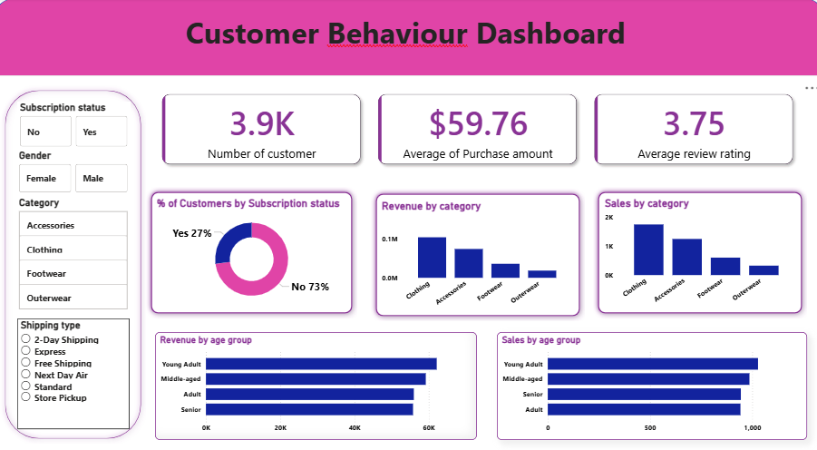
Power BI Dashboard
Interactive dashboard enabling dynamic filtering by gender, category, shipping type, and subscription status

Slide 7


Key Performance Metrics
3.9K
$59.76
3.75
Total Customers
Avg Purchase
Avg Rating
Active customer base analyzed
Average transaction value
Customer satisfaction score
27%
73%
Subscribed
Non-Subscribed
Significant growth opportunity in subscription conversion
Large potential customer base for subscription campaigns

Slide 8

Category & Age Group Performance
Revenue by Category
Revenue by Age Group
Clothing leads in both sales volume and revenue generation
Young Adults generate highest sales and revenue
Clothing: Highest performer
Young Adult: Top segment
Accessories: Strong contributor
Middle-aged: Strong second
Adult: Moderate contribution
Footwear: Moderate sales
Senior: Smallest segment
Outerwear: Lowest contribution

Slide 9
Key Insights
Subscription Power
Smart Discounting
Category Leader
Subscribed customers spend more and generate higher total revenue
Discounts don't negatively impact high-value customers
Clothing is the strongest revenue-driving category
Demographic Focus
Loyalty Connection
Young Adults are the most profitable customer segment
Loyal customers show higher tendency to subscribe

Slide 10





Business Recommendations
Promote Subscriptions
Target returning customers with subscription incentives
Strategic Discounts
Apply discounts selectively on price-sensitive products
Focus Marketing
Concentrate efforts on Young Adult demographic
Loyalty Programs
Convert repeat buyers into subscribers through rewards
Product Priority
Invest in high-rated and high-performing products

